Slide 1
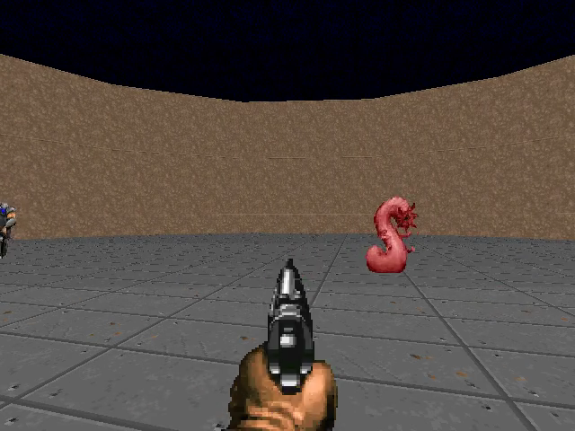
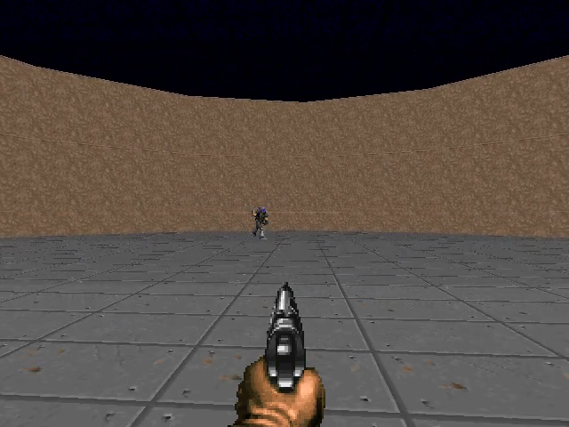
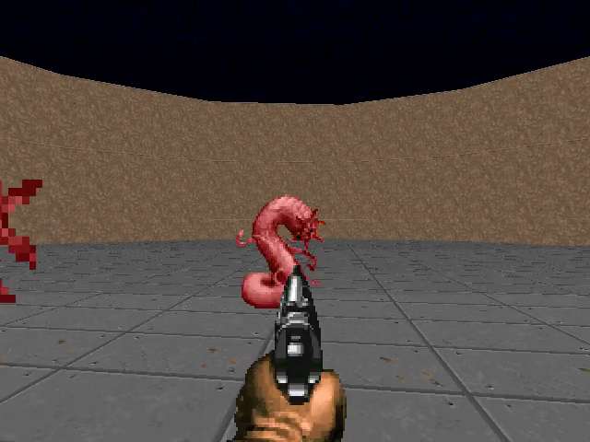
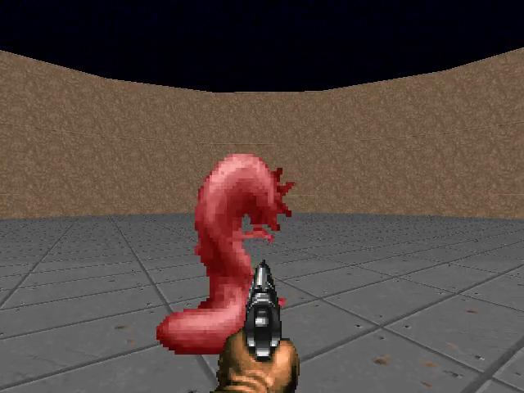
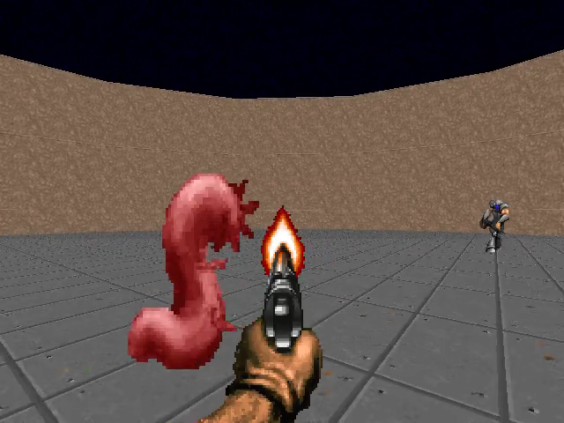
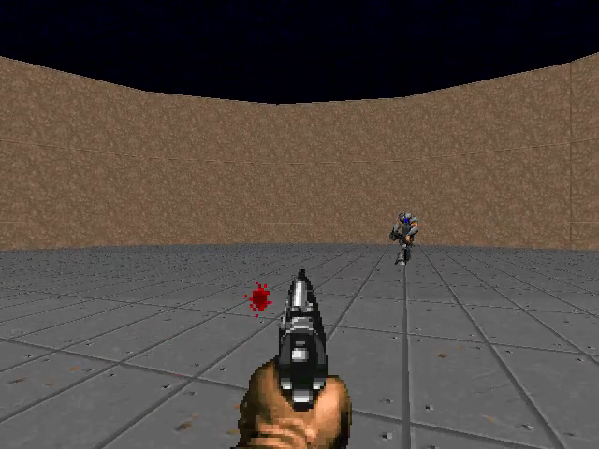
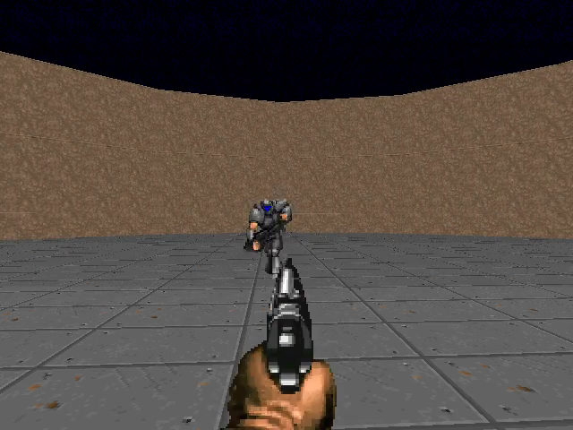
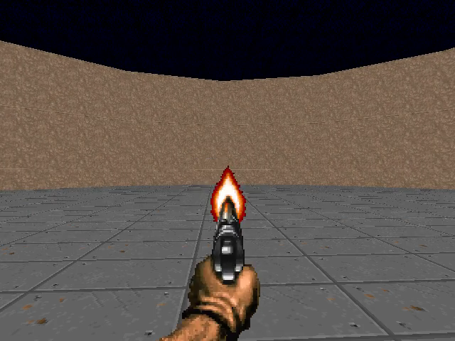
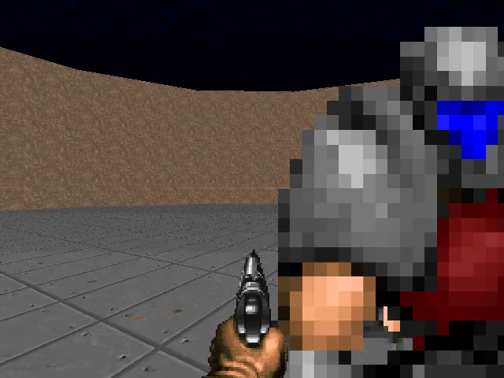
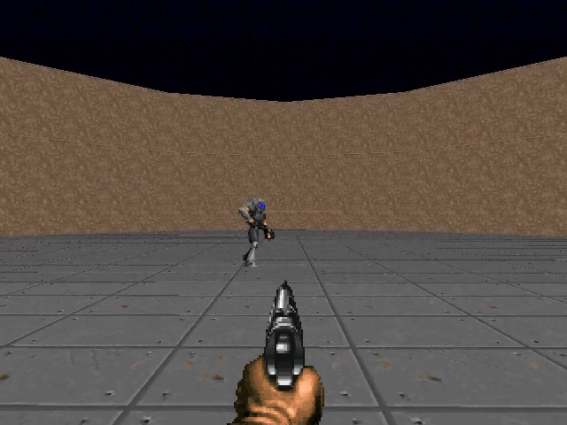
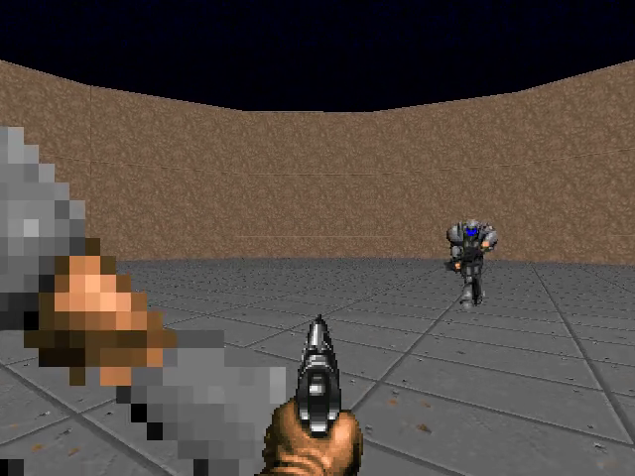
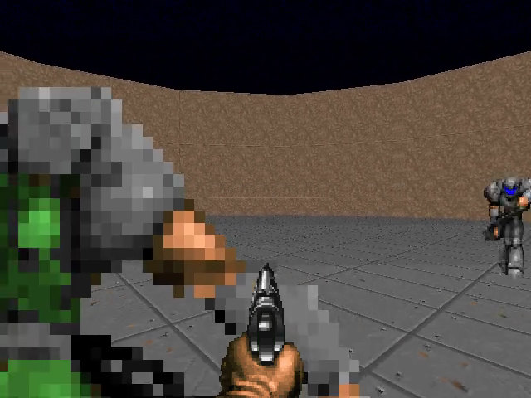
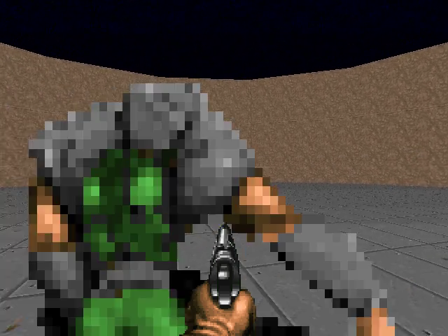
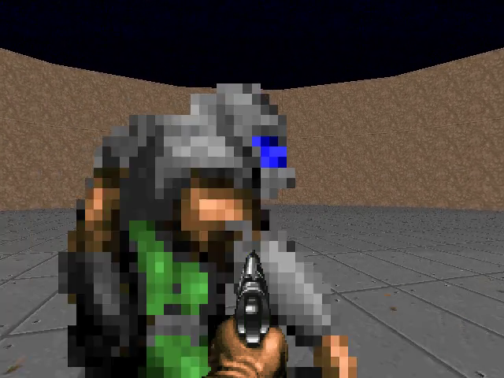
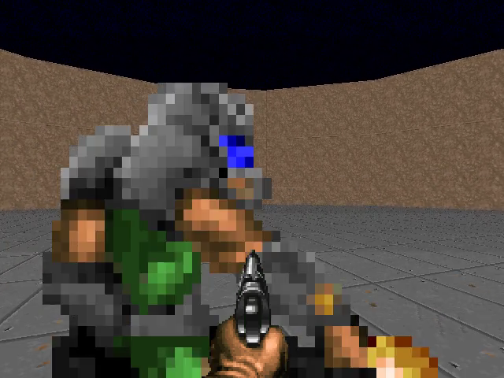
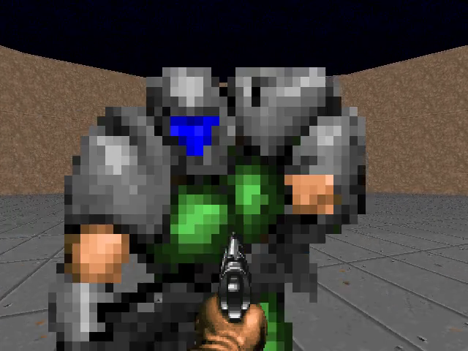
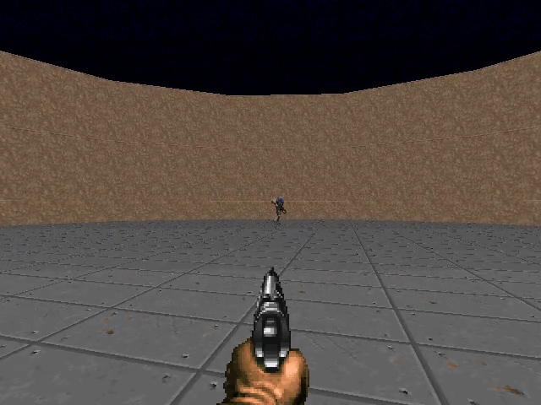
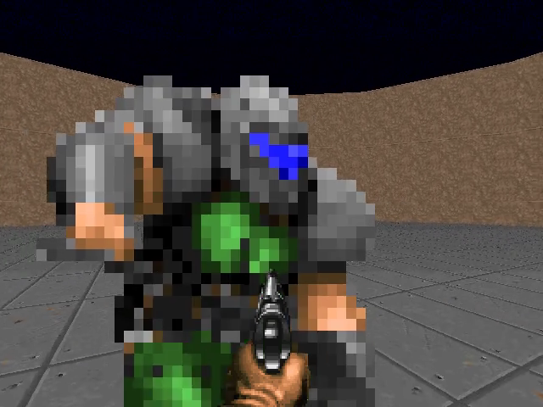
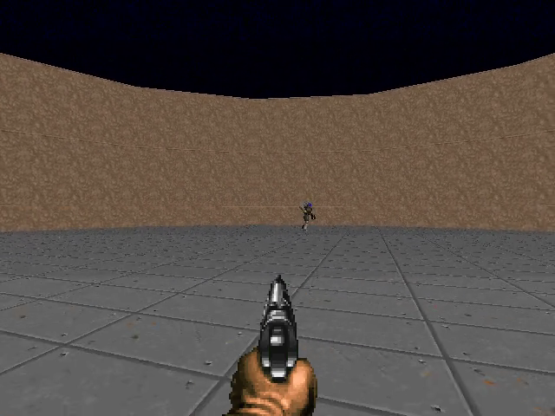
1
Agent 1 (main)
Agent 2 (camera)
Map
1
2
3
4
5
6
7
8
+1
Agent 1 (main)
+1
Agent 2 (camera)
+1
Map
+1

Slide 2
1
Agent 1 (main)
Agent 2 (camera)
Map
+1
+1
1
2
3
4
5
6
7
8
Agent 1 (main)
Agent 2 (camera)
Map
+1
+1

Slide 3
1
Agent 1 (main)
Agent 2 (camera)
Map
+1
1
Enemies
2
3
4
5
6
7
8
Map
Agent 1
+1
+1
Agent 2
Agent 1 (main player)
+1
+1
Agent 2 (cameraman)

Slide 6
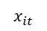
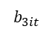
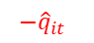
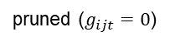
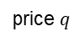
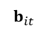
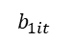
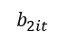
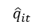
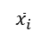
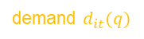
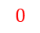
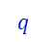
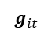
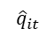
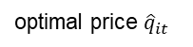
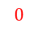
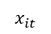
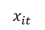

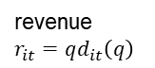
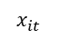
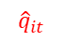
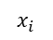
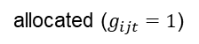
$$b_{it}$$
$$g_{it}$$
$$b_{1it}$$
$${\hat{q}}_{it}$$
✓1
pruned ($g_{ijt}=0$)
allocated ($g_{ijt}=1$)
$$x_{it}$$
$$b_{2it}$$
$$x_{i}$$
$${\hat{q}}_{it}$$
✓1
$$b_{3it}$$
$${\hat{q}}_{it}$$
$$q$$
✘0
1. bidding
2. asking and allocation
revenue
$r_{it}=qd_{it}\left(q\right)$
demand, revenue
$${\hat{q}}_{it}$$
$$−{\hat{q}}_{it}$$
$$x_{it}$$
demand $d_{it}(q)$
$$x_{it}$$
$${\hat{q}}_{it}$$
$$−{\hat{q}}_{it}$$
$$x_{it}$$
$$x_{it}$$
$$0$$
×
optimal price ${\hat{q}}_{it}$
price $q$
$$0$$
$${\overline{x}}_{i}$$
3. payment
4. shipment

Slide 7
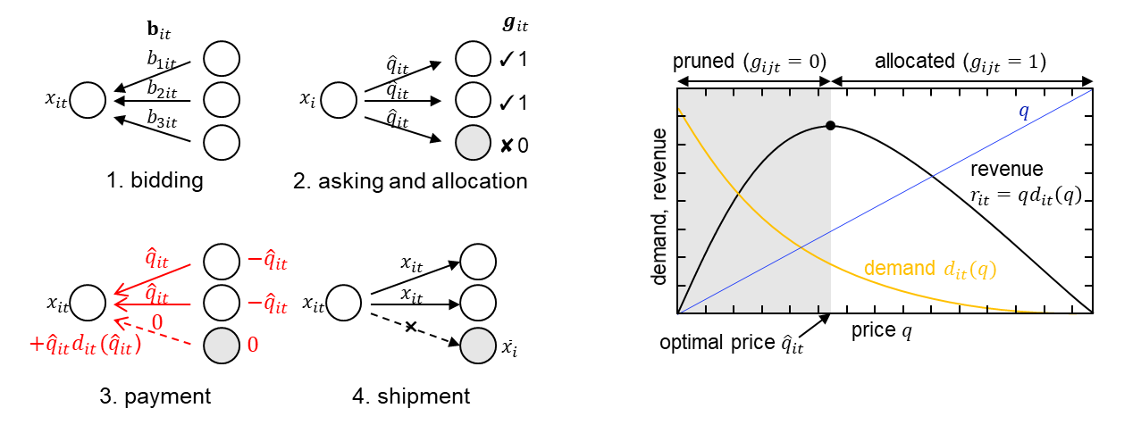

Slide 8
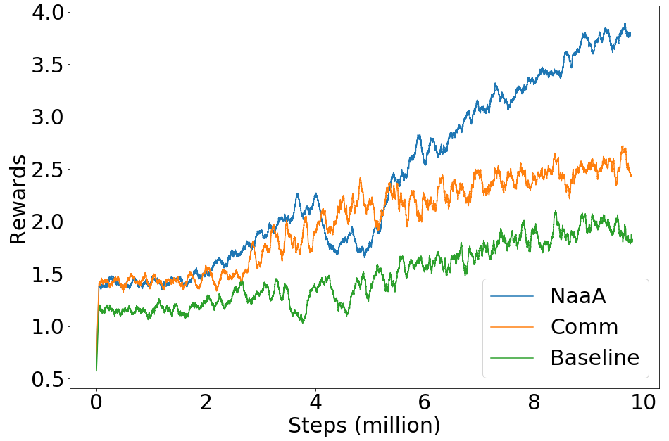
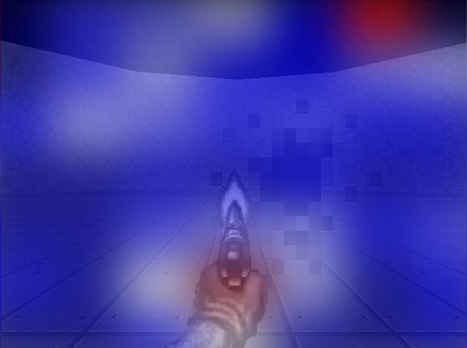
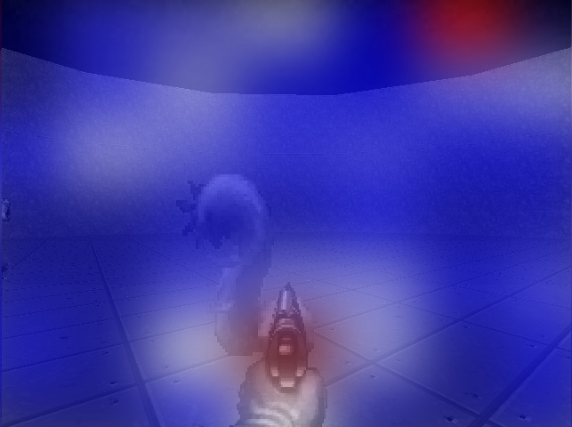

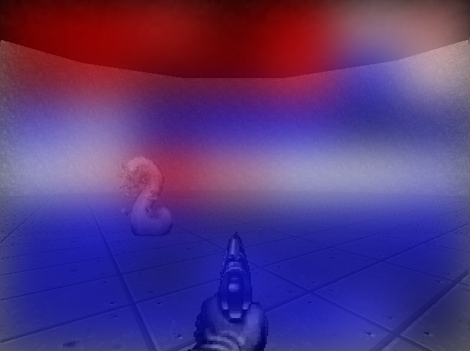
a
b

Slide 11
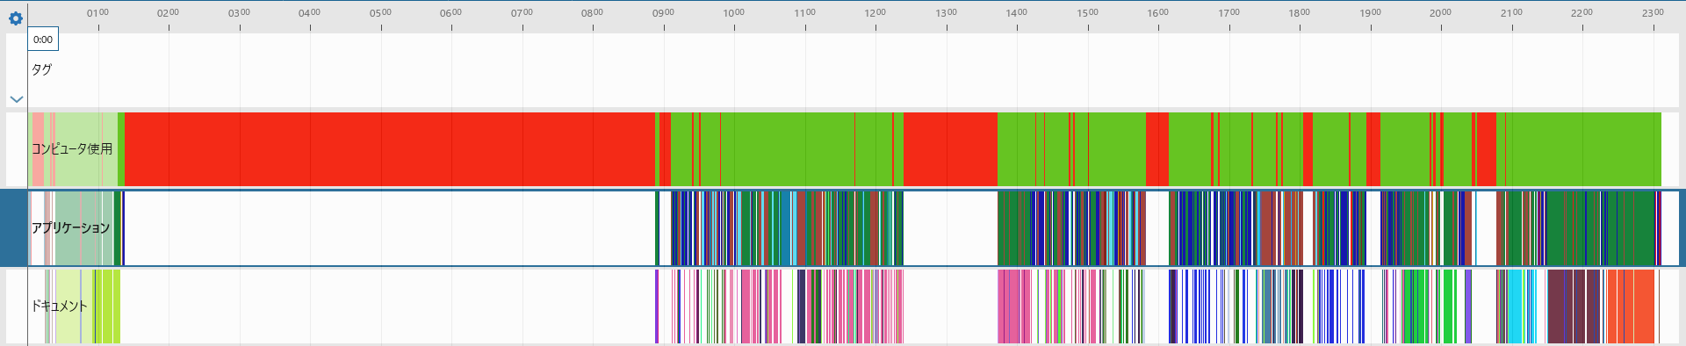
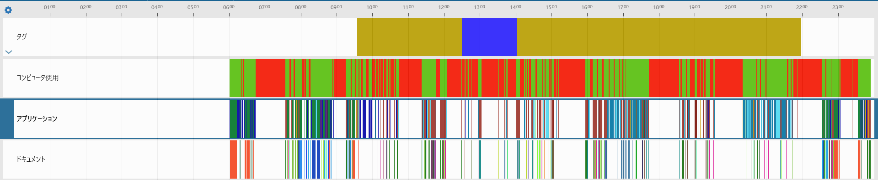





Slide 12

$$b_{it}$$
$$g_{it}$$
$$b_{1it}$$
$${\hat{q}}_{it}$$
✓1
pruned ($g_{ijt}=0$)
allocated ($g_{ijt}=1$)
$$x_{it}$$
$$b_{2it}$$
$$x_{i}$$
$${\hat{q}}_{it}$$
✓1
$$b_{3it}$$
$${\hat{q}}_{it}$$
$$q$$
✘0
1. bidding
2. asking and allocation
revenue
$r_{it}=qd_{it}\left(q\right)$
demand, revenue
$${\hat{q}}_{it}$$
$$−{\hat{q}}_{it}$$
$$x_{it}$$
demand $d_{it}(q)$
$$x_{it}$$
$${\hat{q}}_{it}$$
$$−{\hat{q}}_{it}$$
$$x_{it}$$
$$x_{it}$$
$$0$$
×
optimal price ${\hat{q}}_{it}$
price $q$
$+{\hat{q}}_{it}d_{it}({\hat{q}}_{it}$)
$$0$$
$${\overline{x}}_{i}$$
3. payment
4. shipment

Slide 13










Agent
Agent
$$s_{t},r_{t}$$
$$a_{t}$$
$$s_{t}$$
$$s_{t},r_{t}$$
$$a_{t}$$
Environment
Environment
Environment
$$s_{t}^{1}$$
$$s_{t}^{2}$$
$$a_{t}$$
$$s_{t}^{3}$$
$$s_{t}$$
$$a_{t}$$
Environment
$$R_{t}$$
Environment

Slide 14













$$s_{t}^{ex}$$
External Environment
$$a_{t}^{ex}$$
Internal Environment
Swarm
Internal Environment
State
$$ρ_{t}^{1}$$
$$R_{t}^{ex}$$
$$s_{t}$$
Action
$$ρ_{t}^{2}$$
$$a_{t}$$
$$v_{i}$$
$$R_{t}^{ex}$$
Reward
$$x_{jt}$$
Action
$$ρ_{t}^{3}$$
$$v_{j}$$
$$ρ_{ijt}$$
Reward
External Environment
External Environment
$$a_{t}$$
State
Action
Internal Environment
$$s_{t}$$
$$a_{t}$$
$$R_{t}^{ex}$$
$$R_{it}$$
$$R_{t}^{ex}$$
$$v_{i}$$
Reward
$$x_{jt}$$
$$v_{j}$$
$$ρ_{ijt}$$
External Environment

Slide 15



$$s_{t}$$
Environment
$$a_{t}$$
$$s_{t}^{ex}$$
External Environment
$$a_{t}^{ex}$$
Swarm
Internal Environment
$$R_{t}^{}$$
$$R_{t}^{ex}$$
Agent
$$v_{i}$$
$$x_{jt}$$
Action
$$v_{j}$$
$$ρ_{ijt}$$
Reward
$$s_{t}$$
Environment
$$a_{t}$$
External Environment
$$a_{t}^{ex}$$
Agent
Internal Environment
$$R_{t}$$
$$R_{t}^{ex}$$
$$v_{i}$$
$$v_{i}$$
$$x_{jt}$$
$$x_{jt}$$
$$ρ_{ijt}$$
$$v_{j}$$
$$ρ_{ijt}$$
$$v_{j}$$

Slide 16









$$s_{t}^{ex}$$
External Environment
$$a_{t}^{ex}$$
Swarm
Internal Environment
$$R_{t}^{ex}$$
$$v_{i}$$
$$x_{jt}$$
Action
$$v_{j}$$
$$ρ_{ijt}$$
Reward
$$s_{t}$$
Environment
$$a_{t}$$
$$s_{t}$$
Environment
$$a_{t}$$
External Environment
$$a_{t}^{ex}$$
Agent
Internal Environment
$$v_{k}$$
$$R_{t}^{}$$
$$R_{t}$$
$$R_{t}^{ex}$$
Agent
$$v_{k}$$
$$v_{i}$$
$$v_{i}$$
$$x_{jt}$$
$$x_{jt}$$
$$v_{j}$$
$$ρ_{ijt}$$
$$ρ_{ijt}$$
$$v_{j}$$

Slide 17













$$s_{t}^{ex}$$
External Environment
$$a_{t}^{ex}$$
Swarm
Internal Environment
$$R_{t}^{ex}$$
$$v_{i}$$
$$x_{jt}$$
Action
$$v_{j}$$
$$ρ_{ijt}$$
Reward
External Environment
$N_{i}^{in}$
$N_{i}^{out}$
$$s_{t}$$
Environment
$$a_{t}$$
$$a_{t}^{ex}$$
$$s_{t}$$
$$a_{t}$$
Agent
Internal
Environment
Environment
$$v_{i}$$
$$R_{t}^{}$$
$$R_{t}$$
$$R_{t}^{ex}$$
2
1
(d)
Agent
$$v_{i}$$
$$v_{i}$$
$$ρ_{ijt}$$
$$x_{jt}$$
$$ρ_{ijt}$$
$$v_{j}$$
$$v_{j}$$
$$v_{i}$$
$$c_{it}$$
$$r_{it}$$
(a)
(b)
(c)
(e)

Slide 18












$$s_{t}$$
Environment
$$a_{t}$$
External Environment
$$a_{t}^{ex}$$
$$s_{t}$$
$$a_{t}$$
Agent
Internal
Environment
$N_{i}^{in}$
$N_{i}^{out}$
Environment
$$a_{t}^{ex}$$
$$R_{t}^{}$$
$$R_{t}$$
$$R_{t}^{ex}$$
2
1
$$v_{i}$$
$$R_{t}^{ex}$$
Agent
$$v_{i}$$
$$v_{i}$$
$$x_{jt}$$
$$x_{it}$$
$$ρ_{ijt}$$
$$x_{jt}$$
$$c_{it}$$
$$v_{i}$$
$$r_{it}$$
$$v_{j}$$
$$v_{j}$$
$$ρ_{ijt}$$
(e)
(d)
(a)
(b)
(c)
Environment

Slide 19
Neuron as an Agent
$$s_{t}$$
Environment
$$a_{t}$$
External Environment
$$a_{t}^{ex}$$
$$s_{t}$$
$$a_{t}$$
Agent
Internal
Environment
$N_{i}^{in}$
$N_{i}^{out}$
Environment
$$a_{t}^{ex}$$
$$R_{t}^{}$$
$$R_{t}$$
$$R_{t}^{ex}$$
2
1
$$v_{i}$$
$$R_{t}^{ex}$$
Agent
$$v_{i}$$
$$v_{i}$$
$$x_{jt}$$
$$x_{it}$$
$$ρ_{ijt}$$
$$x_{jt}$$
$$c_{it}$$
$$v_{i}$$
$$r_{it}$$
$$v_{j}$$
$$v_{j}$$
$$ρ_{ijt}$$
(e)
(d)
(a)
(b)
(c)
Environment
Environment
Agent
Agent
Agent
Agent

